Slide 1
Where To Build?
Ryan B., Nichole E. & Kayla K.

Slide 2
Motivation & Summary Slide
Hypothesis:
A resort company wants to invest in a new property. They are interested in analyzing certain travel data and competing with the best of the best.
Questions:
Does the Rating of the Hotel drive the Price?
Why: It is necessary to determine the price range we want to be in for travelers.
What cities have the most popular activities based on reviews?
Why: When people travel you want to give your guest activities and attractions nearby.
What places are currently more expensive to travel?
Why: traveler typically have a budget, we have to be in a budget range that is affordable.

Slide 3
Motivation & Summary Slide cont..
Satisfaction:
For the datasets that are available this project was completed to the best of the teams ability with out FREE Budget.
Finding solid APIs was a bit challenging for the team.
Ensuring the dataset was reliable and could generate data was always a concern
Flight Data was limited based on the questions we proposed. Therefore picking a outgoing city bounded the dataset to one area.
Attractions data was not categorized properly.

Slide 4
Questions & Data
Does the Rating of the Hotel drive the Price?
Hotel API data is needed that covers variables such as ”hotel star rating”, “average cost for a 1 Bedroom, etc.
Data set found via Rapid API, Hotels.com FREE API.
What cities have the most popular activities based on reviews?
Attraction API data is needed that give popular attractions in a city with ratings/reviews
Data set found via Rapid API, YelpAPI Free.
What places are currently more expensive to travel?
Hotel API and Flight API. This will cover the average cost of a stay and competing hotels and the average flight cost, outgoing and returning.
Data set found via Rapid API, Hotels.com FREE API & Skyscanner Flight Search API

Slide 5
Data Cleanup & Exploration
The team was able to find a public API platform that contained several categories such as entertainment, travel, weather, ect…..
APIs found from this public API platform included Hotel.com (hotel), Yelp.com (notable attractions) and Skyscanner.com (flight)

Slide 6
Data Cleanup & Exploration
Exploration:
The team was able to find a public API platform that contained several categories such as entertainment, travel, weather, ect…..
APIs found from this public API platform included Hotel.com (hotel), Yelp.com (notable attractions) and Skyscanner.com (flight)
Cleanup:
API – For each API acquired a FOR LOOP was created
For flight data – generated data for outbound flights source with a fixed Airport location , looping cities. Then repeated for returning flights.
For Hotels - generated data for Hotels looping by Lat and Lng of cities
Yelp – generated attractions for locations by looping cities
Merged all data sets by cities
Removed all Flight data that did not generate max or min pricing
Due to Fixed outbound there are cities in which there is no direct flight

Slide 7
Data Cleanup & Exploration cont….
Figures:
During exploration the only figures generated where data frames.
Imported a developed Cities.csv
Appended Flight, Hotel and Attraction columns to csv.

Slide 8
Data Cleanup & Exploration cont….
Insight:
Being locked into one outbound airport
Correlation between hotel rating and hotel price
Weather analysis creates outliers based on location, i.e. Alaska vs Florida
Problems:
State was defined differently in some dataset, renaming columns and giving them their own dataset

Slide 9
Data Analysis
Summary Breakdown
Imported merged.csv
Contains all data from APIs
Question one
Generated a regression plot to determine effect of hotel rating on price
Generated a line graph to determine total cost (hotel price vs city ) to determine which cities are more expensive.
Sub category East vs West Hotel Price Longitude
Question two
Generated a bar plot to determine popular activities based on city.
Question three
Generated a bar graph to determine total cost (hotel and flights) to determine which states are more expensive to travel to.
Addition data
Generated a heatmap to visually look at temperature.

Slide 10
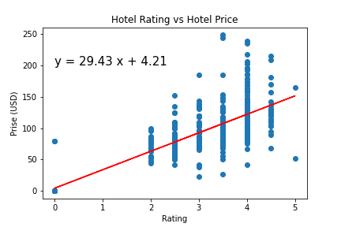
Data Analysis: Regression / Correlation Hotel Review and Price
Question:
Does the Price of the Hotel drive the rating?
Observation:
There is a moderate correlation between the price of the hotel and the rating.
In this instance it appears that there is still some variations that exist. We want a r-value larger than 0.7. More data will be needed to draw this conclusion.
It appears the review data is just the average review and not categorized.
R= 0.64

Slide 11
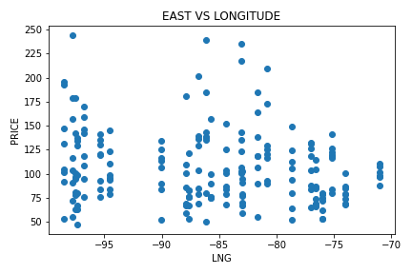
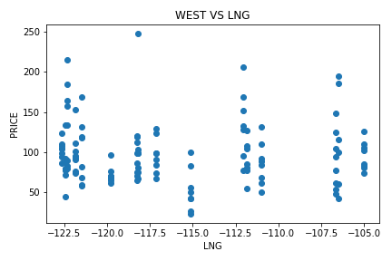
Data Analysis: Regression / Correlation Hotel Review and Price
Question:
Does the Price of the Hotel drive the rating?
Observation:
There is a no correlation between the price of the hotel and its longitude.
A factor that may have a stronger correlation to (hotel) cost may be population.
Additional API data would be needed

Slide 12
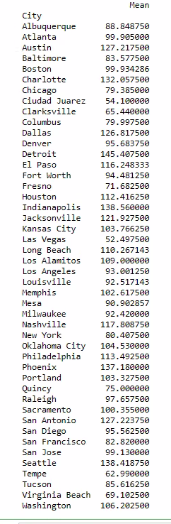
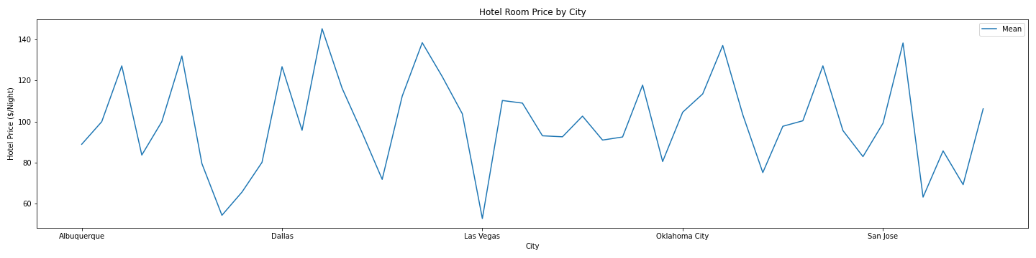
Data Analysis: Line chart, Hotel: Cities vs AVG Price
Ref. Num. | City | Avg. Price
1 | Austin | $127.22
2 | Charlotte | $132.06
3 | Detroit | $145.48
4 | Indianapolis | $138.56
5 | Phoenix | $137.18
6 | Seattle | $138.42
Observation:
These six locations have been identified as the cities with the highest hotel rate.
1
3
4
6
5
2
NOTE: Red numbers on the bar chart are reference numbers that correlate with the chart.

Slide 13
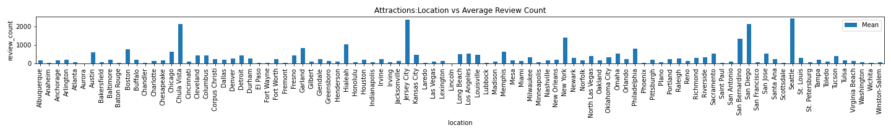
Data Analysis: Bar chart Plot, Attractions: Location vs AVG Review Count
Ref. Num. | City, State | Approx. Avg. Reviews
1 | Chula Vista, CA | 2000
2 | Jersey City, NJ | 2300
3 | New York, NY | 1000
4 | San Bernardino, CA | 1000
5 | San Diego, CA | 2000
6 | Seattle, WA | 2300
Question:
What cities have the most popular activities based on reviews?
Observation:
These six locations have been identified as the locations with higher reviews of their attractions.
1
2
5
6
3
4
NOTE: Red numbers on the bar chart are reference numbers that correlate with the chart.

Slide 14
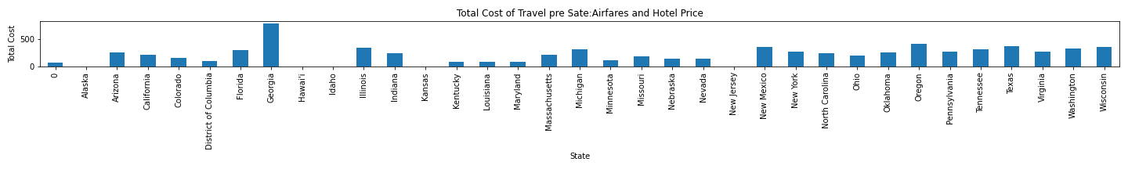
Data Analysis Bar chart Plot, Total Cost per State: Airfare and Hotel Price
Question:
What places are currently more expensive to travel?
Observation:
These six state have been identified as the states that is would be more expensive to travel to based on outbound flight, inbound flight and hotel price
Many Factors may not be included
View Extra slide for Total Cost By City
2
3
4
5
6
1
NOTE: Red numbers on the bar chart are reference numbers that correlate with the chart.

Slide 15
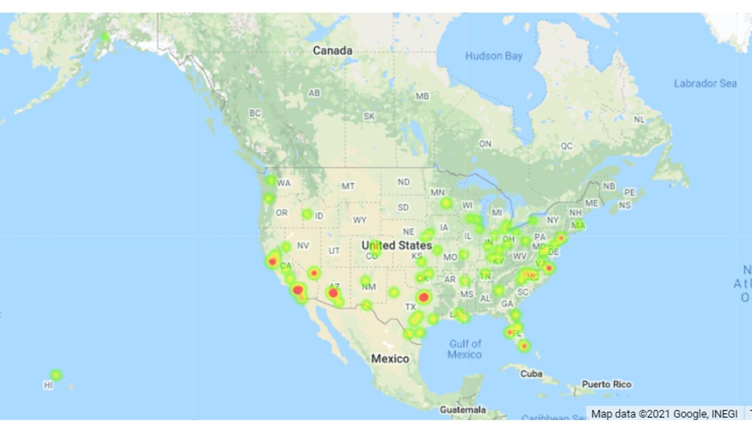
Data Analysis: Heatmap
Additional Data
Observation:
Max temperatures for the week of travel
Seasonal data would cost more to be generated

Slide 16
Considerations
The Hotel and Flight data sets have firm dates set of 3/15/2021 - 3/19/2021.
This can be modified and multiplied to cover more dates or seasons.
The Flight data has a firm Outbound (BWI, going), Inbound (IAD, returning) airport.
This can be modified and multiplied to cover more outbound or inbound airports
More datasets can be added to present a stronger case.
Ex: Hotel Data is the average review, its not split into categories such as cleanliness, service, booking, food service, guest interaction, etc…..
The team has demonstrated the capability to extract weather, so, if request either current or projected weather data, we would need a capital investment to extract that data from the API.

Slide 17
Discussion
In general, we were able to find data for at least a category to make up the main data frame, There are a lot of factors to consider when building a resort a comparative advantage can be the price nonetheless, attractions and ratings could be an absolute advantage.
From the data set we have determined:
Hotel Rating can determine the price range for your hotel
Travelers seem to flock California, New York, New Jersey and Washington based on attraction reviews from yelp.
Considering a travelers budget can also determine where people might travel.
Some places are less expensive than others.

Slide 18
Post Mortem
Some APIs were incomplete therefore we had to run multiple times to generate data. That ultimately created a situation when we ran over our daily call limits.
If we had more time, we could have found more data to add to the overall data set, maybe, possibly a data set with better parameters to offer.
We also could have created our own questionnaire and carried out a survey to determine an analysis of location the sample data would actually choose to go for a resort vacation and the factors influencing the decision

Slide 19
Data Sets
RapidApi
Yelp (https://rapidapi.com/serg.osipchuk/api/YelpAPI/details)
Hotel.com (https://rapidapi.com/yahoo.finance.low.latency/api/hotels-com-free)
Skyscanner (https://rapidapi.com/skyscanner/api/skyscanner-flight-search)
OpenWeather

